Slide 1
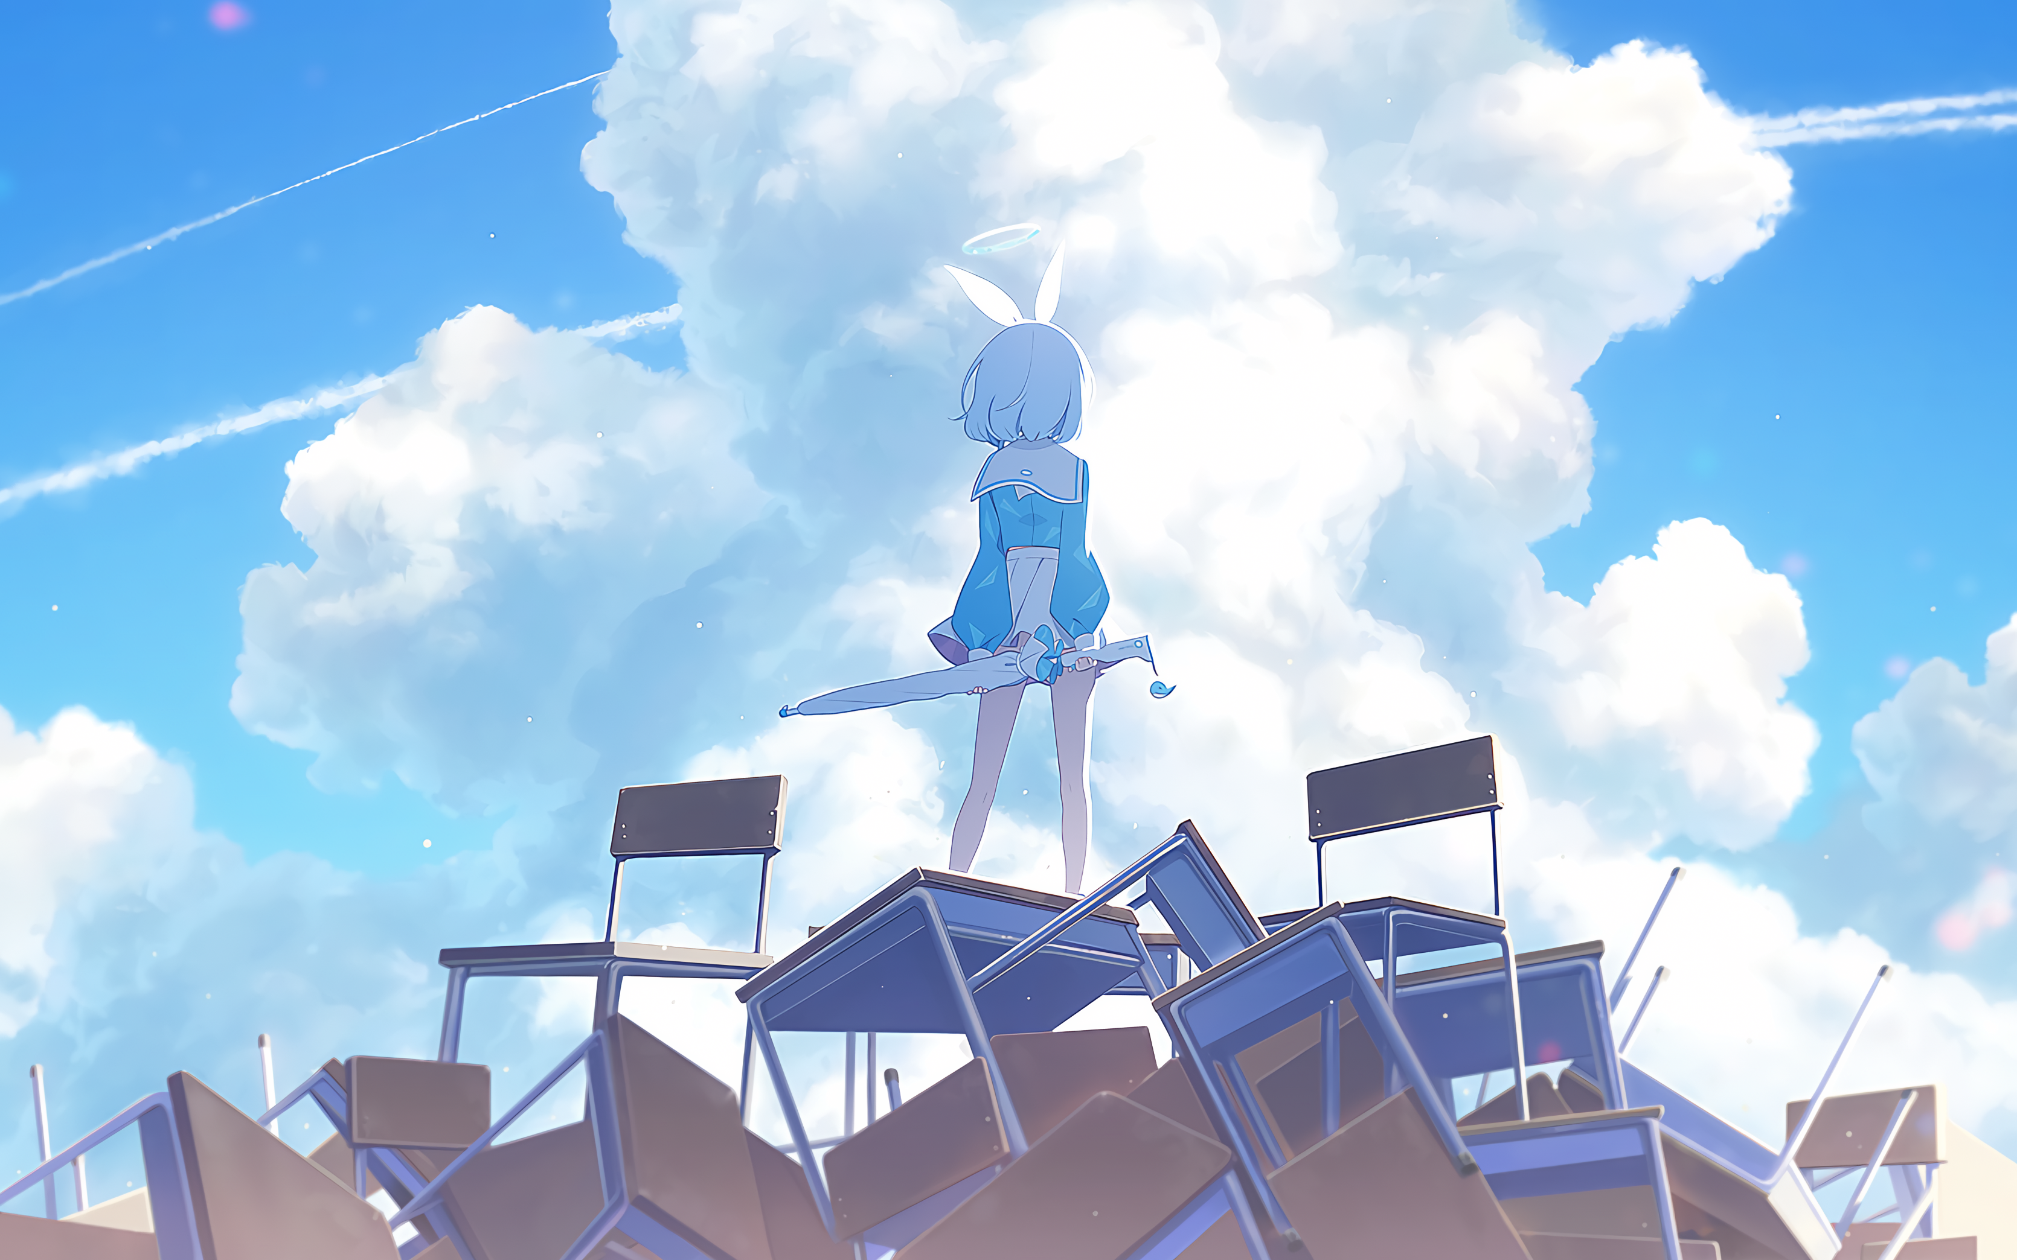
Empowering Humanity™
Brief demonstration of various AI technology
BG: Fictional AI personality Arona from video game BlueArchive

Slide 2
* Generate / modify content (Image, text, etc.) to solve difficult-for-human tasks.
CAPABILITIES

Slide 3

1. DIFFUSER - Image generation
Stable Diffusion
Model Counterfeit-V3.0
Prompt (masterpiece, best quality), a girl standing on a cluster of school tables and chairs, holding an umbrella and looking towards the sky, hayase yuuka, blue sky, chair, cloud, cloudy sky, condensation trail, day, desk, horizon, outdoors, scenery, school desk, short hair, sky, solo, wind, camera from behind,<lora:hayaseYuuka>
COMMON TYPES & USAGE

Slide 4

1. DIFFUSER - Image generation
Stable Diffusion
Model Counterfeit-V3.0
Prompt (best quality, good quality), a girl running on a track outdoor, cinematic, full body, ultra-detailed, Hayase Yuuka, gym uniform, <lora:hayaseYuuka>
COMMON TYPES & USAGE

Slide 5
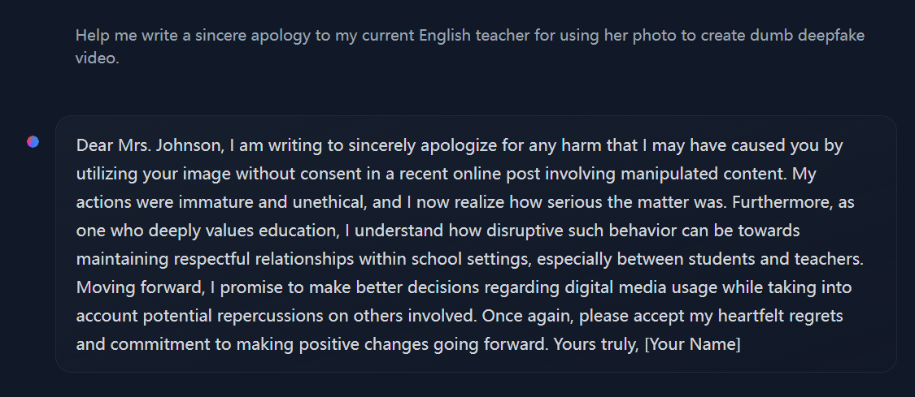
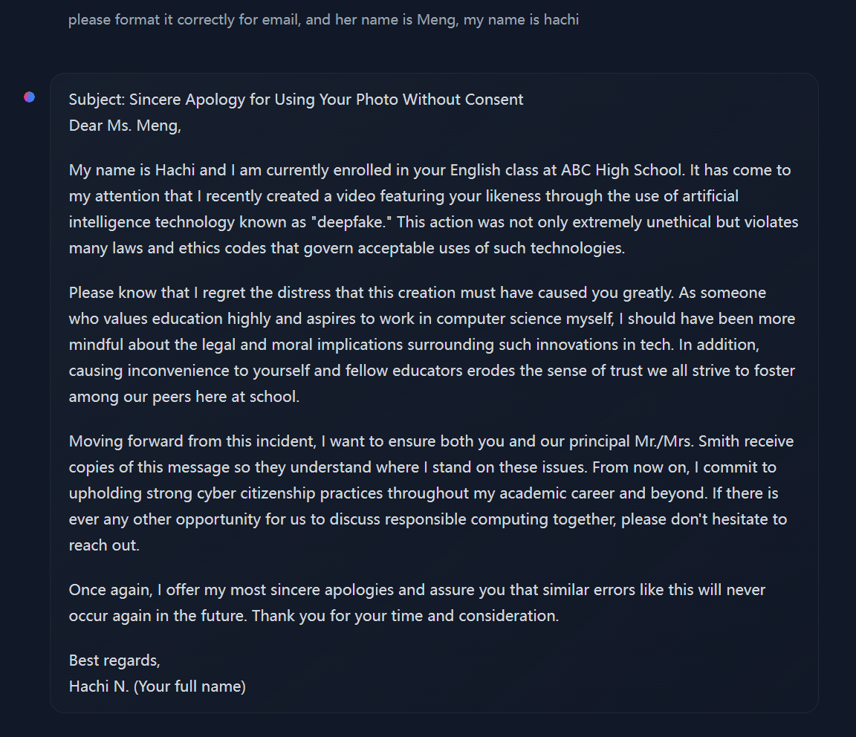
2. TRANSFORMER - Text generation
Tool used: HuggingChat hf.co/chat
COMMON TYPES & USAGE

Slide 6
HuggingChat (hf.co/chat)
Open-Source alternate for models like GPT-4
BREAKING PAYWALL

Slide 7


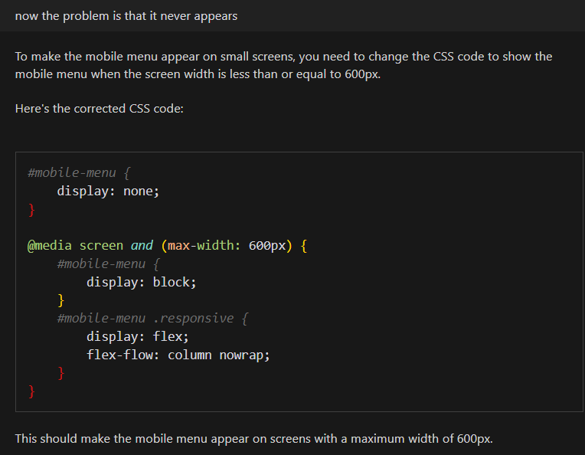
GPT-4
Supports various languages
Proprietary & Not free
Only usable via OpenAI’s API
BREAKING PAYWALL

Slide 8

Open Assistant
Supports English well
Free for all
Can be deployed offline
BREAKING PAYWALL

Slide 9
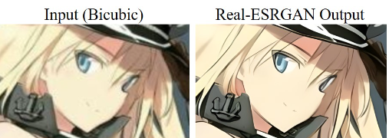
3. GAN(Generative Adversarial Network) - Restoration (e.g. Upscaling, Denoising images/videos)
COMMON TYPES & USAGE

Slide 10
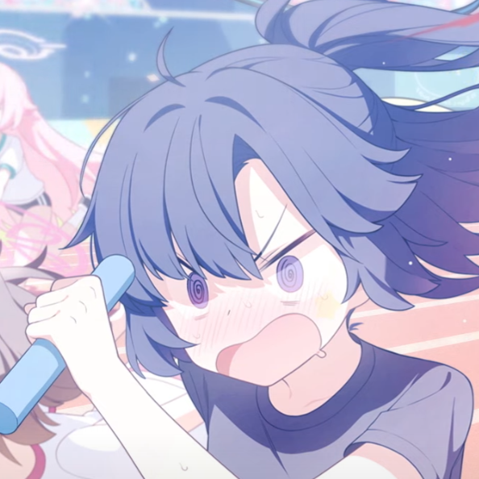

ORIGINAL
UPSCALED
Real-CUGAN 2x Upscale
Increase Image Clarity
COMMON TYPES & USAGE

Slide 11
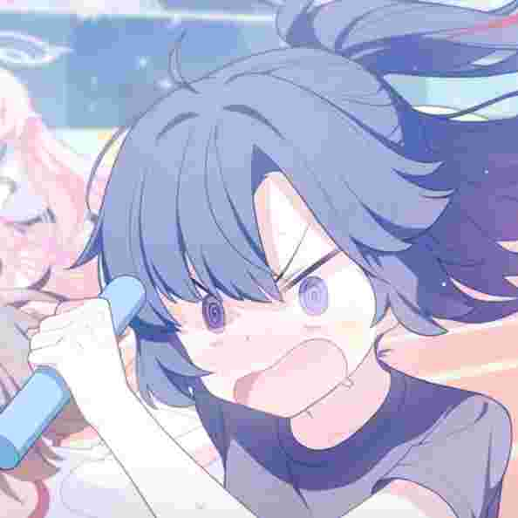

ORIGINAL
UPSCALED
Real-CUGAN 2x Denoise + Upscale
Remove Compression Artifact
COMMON TYPES & USAGE

Slide 12
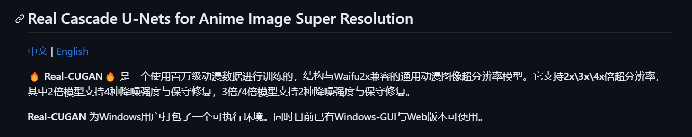
Real-CUGAN (NCNN)
Min. Requirement: GPU ≥ GTX 1050, 8G RAM
Can be found on GitHub
https://github.com/nihui/realcugan-ncnn-vulkan
TRY IT YOURSELF

Slide 13
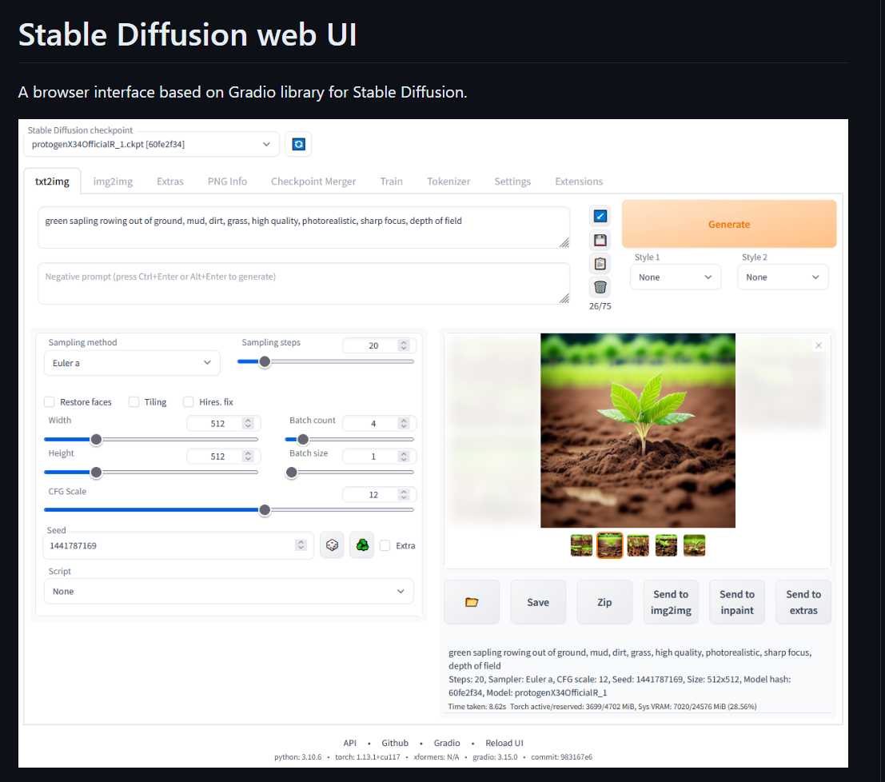
Stable Diffusion (WebUI)
Min. Requirement: GPU ≥ GTX 1060, 16G RAM
Can be found on GitHub (Require manual setup)
https://github.com/AUTOMATIC1111/stable-diffusion-webui
TRY IT YOURSELF

Slide 14
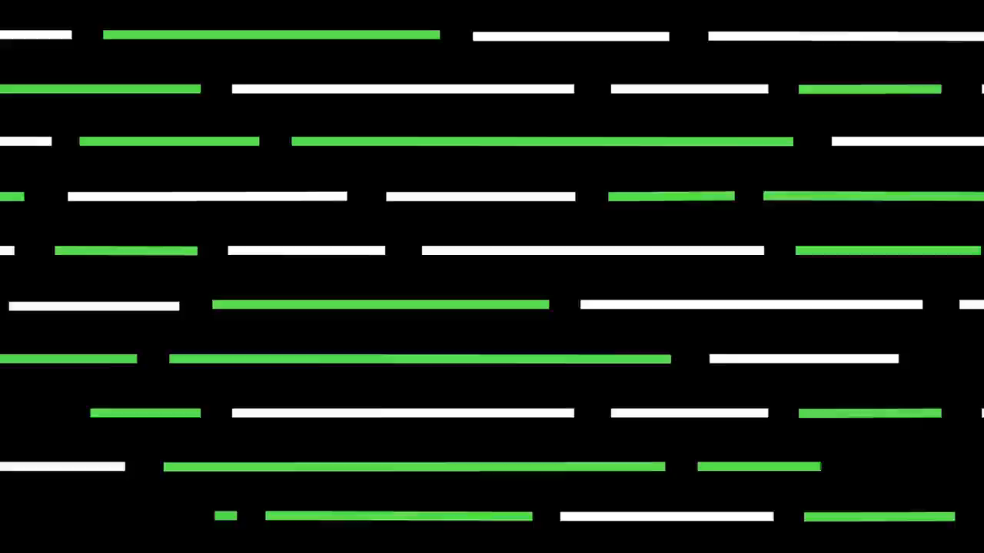
GPT-4 INTRODUCTION

Slide 15
GPT-4 INTRODUCTION

